Slide 1
Fake NEWS Detection Using Machine Learning Under the faculty guidance of M .Sathyam Reddy Asst Prof, M. Tech
Team members
G .Lakshmijyothi (19471A0521)
S .Satya vathi (19471A0554)
D .Susmitha (19471a0515)

Slide 2
Abstract
The phenomenon of Fake news is experiencing a rapid and growing progress with the evolution of the means of communication and Social media.
People don’t have enough time to read the newspaper , so they utilize social media to keep up with the latest news.
All the news that we hear from social media can not be trusted because all of them may not be real . So, it is important to detect fake news.
The objective of this project is to implement fake news detection using an appropriate machine learning technologies.
In this project we will train the machine learning classification techniques to predict whether the given news is real news or fake news.

Slide 3
CONTENTS
Introduction
Literature Survey
Proposed System
System Architecture
Data Preprocessing
Models in ML
Result Analysis
Output Screens
Conclusion

Slide 4
Introduction
Fake news is false or misleading information presented as news.
It often has the aim of damaging the reputation of a person or entity, or making money through advertising revenue.
However, the term does not have a fixed definition, and has been applied more broadly to include any type of false information, including unintentional and unconscious mechanisms, and also by high-profile individuals to apply to any news unfavorable to their personal perspectives. There are many websites, social media, political news, and click baits.

Slide 5
Literature survey
We have studied below two research papers to understand the process of Fake News Detection
Author | Publication | Problem | Methodology | Remarks
Dr .S. Rama Krishna, Dr .S .V . Vasantha , K . Mani Deep | IEEE(2020) | Fake News Detection | CNN,LR ,LSTM and SGD | Compared to all SGD obtain low accuracy.
Shailender Kumar, Subodh Kumar, Pooja Yadav, Meghana Bagri. | IEEE(2021) | Fake News Detection | SVM , Naive Bayes And KNN | Compared to all SVM obtain low accuracy.

Slide 6
Proposed system
It is very import to detect the Fake News.
Some steps to check whether the news is true or false.
It will compare news which is given by our side with different websites and various news sources .
If that news is found on any news website then it shows the given news is true, else it shows there has been no such news in last few days. This can help us from fake news.
These days fake news spread very fast because of social media and the internet.
So, news authenticator helps us to detect either the given news is fake or real.
For this we are using Classification Models like Logistic Regression, Random Forest Classifier, Decision Tree Classification and Naive Bayes Classifier.

Slide 7
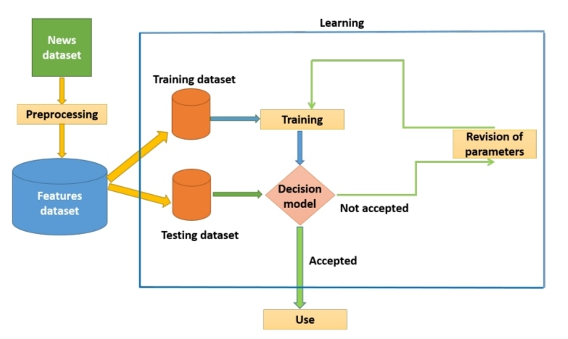
System architecture
The preprocessed dataset is divided into two parts : The first for training and the second for testing.
Different machine learning algorithms like Logistic Regression, Random Forest Classifier, Decision Tree Classifier and Naive Bayes are used.
After that we will predict the accuracy by using testing dataset on the models.

Slide 8
Data preprocessing
The dataset is collected from :https://www.Kaggle.com/datasets/fake-news-detection.
We get the data set from the Kaggle website . The dataset contains five columns and more than 20000 rows.
The dataset contains the columns as id ,title ,author ,text ,label.
The data contains null values , we filled those null values with space . The data contains textual data. First we cleaned the data and apply stemming is the process of reducing inflected words to their root or base.
For easy process we merged title and author columns as single column such as “content”.
We have used bag of words and N-grams and After that we applied TF-IDF (Term Frequency-Inverse Document Frequency) feature extraction technique .
TF-IDF is a feature extraction technique that transforms text documents into a vector space model using term frequencies and inverse document frequencies.

Slide 9
Models in ml
Model selection is the process of selecting different machine learning algorithms – SVM ,CNN , Logistic Regression ,Decision Tree Classifier and Random Forest etc .
Some of the algorithms used in the project are : Logistic Regression ,Decision Tree Classifier ,Naive Bayes and Random Forest.
Although we used different algorithms , we obtained higher accuracy for Decision Tree Classifier and it is also very efficient algorithm compared to other algorithms.

Slide 10
Decision tree classifier
Decision Tree Classifier is a type of supervised learning algorithm (having a predefined target variable) .
The Decision Tree Classifier algorithm improves the flexibility and decision making capacity of individual trees.
It is one of the machine learning algorithm incorporating the ensemble learning theorem as its foundation , combining results from various decision trees to optimize training.
In some use cases of loan and credit risk prediction , some features are more important than the rest or , more specifically , some features whose removal would improve the overall performance.
Since we know the fundamentals of decision trees and how they choose features based on information gain , decision trees would incorporate these benefits to give superior performance.

Slide 11
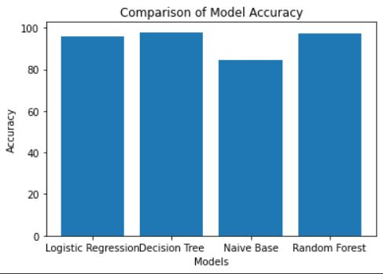
Result analysis

Slide 12

Output screens

Slide 13


Output for real news

Slide 14


Output for fake news

Slide 15
conclusion
This presents a method of detecting fake news using, different machine algorithms trying to determine the best features and techniques to detect fake news.
The implemented solution that uses a dataset of news preprocessed using cleaning techniques , bag of words and n-grams concept etc.
The Decision Tree Classifier seems the best algorithm to detect fake news with high accuracy as 98% than the existing.

